Slide 1
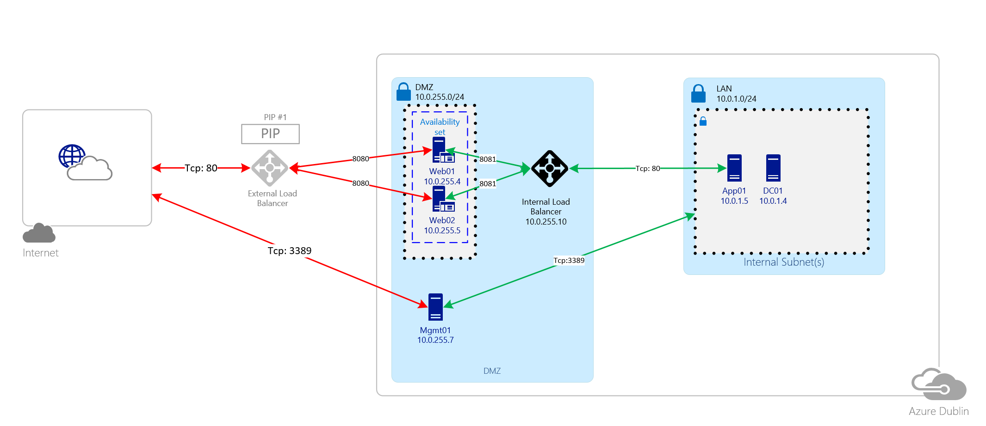

Lets build this

Slide 2
Lab Guide
You are all using a single Azure Subscription. IP Address ranges will overlap. You can ignore the errors.
Attendees will pair up and work together. You will be given a unique number e.g. 03
All Resources should be a in single Resource Group e.g. VNETxx where XX is your group number e.g. VNET03
All VMs should be A2v2 in size
App01 and DC01 are domain joined. All other VMs are workgroup.

Slide 3
Lab Guide
Be sure that that IP addresses for servers match the EXCEL sheet.
Don’t forget to put the web servers in an availability set (I bet you will forget).
Install IIS components on the web servers are per the EXCEL sheet.
When IIS installed run the create-iis-site-webxx.ps1 PowerShell Script locally
When the App server has been configured run the file-share-app01.ps1 script

